Slide 1
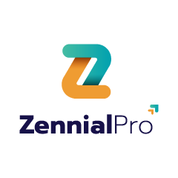
Automated File Filtering and Loading from Amazon S3 to Azure SQL using Azure Data Factory

Slide 2
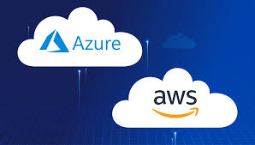

Why ?
Multi-cloud connectivity is a key skill for every data engineer
Transfer only useful files instead of moving everything
Ensures seamless integration across platforms
Saves time and reduces cost
Provides faster and more reliable insights through automation

Slide 3
Scenario Overview
•This Scenario integrates Amazon S3 with Azure Data Factory to enable secure and automated data transfer.
It processes only the files that are larger than 100KB and have more than 999 rows, ensuring efficiency and relevance.

Slide 4
Agenda
• Amazon S3 Setup
• User and Permission Configuration
• Azure Data Factory – Linked Services
• ADF Pipeline Overview
• Filtering Logic – File Size & Row Count
• Data Load to Azure SQL / Error Handling
• limitations
• Conclusion

Slide 5
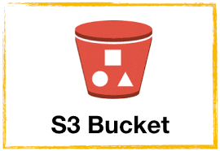
Amazon S3 Bucket
Create an S3 bucket and add files.
Ensure the bucket has proper permissions
S3 provides cost-effective object storage

Slide 6
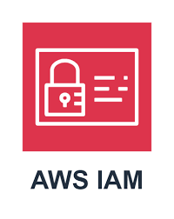
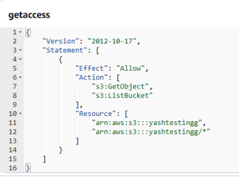
IAM Roles and Policies
Create an IAM User in AWS.
Generate Access Key & Secret
Attach S3 access policies
Sample code →

Slide 7
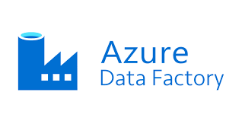
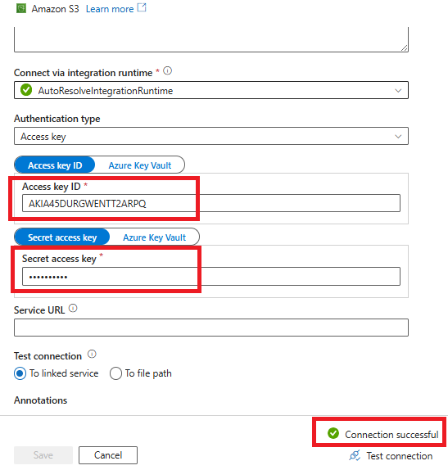
Linked service in Azure
Open Azure Data Factory.
Create Linked Service → Select Amazon S3
Provide Access Key & Secret.
Test the connection

Slide 8
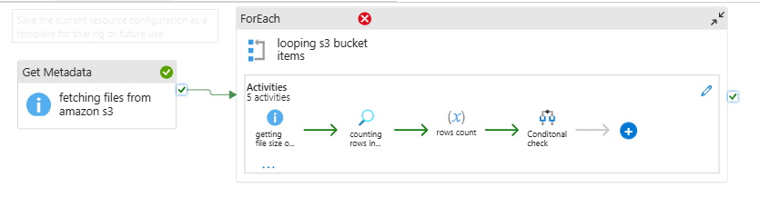
Azure Pipeline Creation
Fetch files from Amazon S3
Validate file size and row count.
Based on filtering and load into Azure SQL

Slide 9
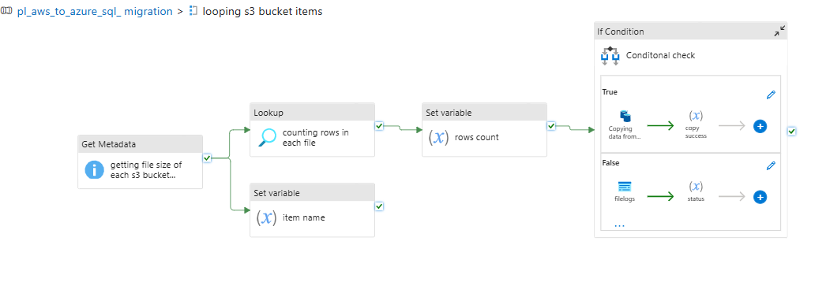
Pipeline Execution

Slide 10
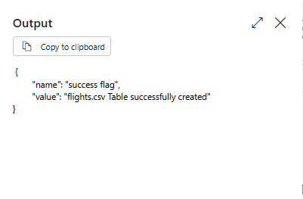
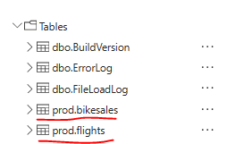
Pipeline Success

Slide 11
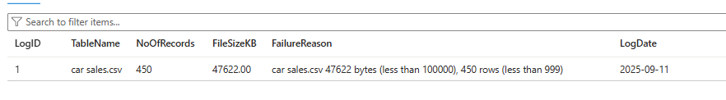
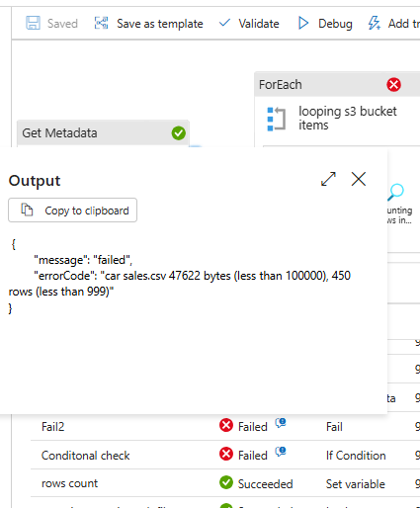
Pipeline Failure

Slide 12
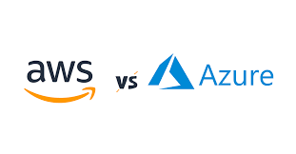
AWS vs Azure Pricing & Migration Reasons
AWS S3 offers cheap storage
Azure often provides lower compute/analytics costs.
Flexible pricing for enterprises
Migration Reasons:
Unified ecosystem (Power BI, Synapse).
Simplified identity management (Azure AD).

Slide 13
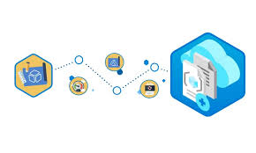
Limitations
Credential management complexity.
Latency in cross-cloud transfers.
Higher costs for large-scale transfers.
Security & compliance challenges.
Complex monitoring.

Slide 14
Conclusion
Azure Data Factory integrates, seamlessly with Amazon S3.
IAM roles ensure secure access
Linked Services + Pipelines enable automation.
Careful planning is needed for cost and security.

Slide 15
Thank You!!!

